Slide 1
The Disease Prediction System
Team Member Ashish Thami [360272] Sailendra Bhattarai [360282] Sushil Shrestha [360288]

Slide 2
Introduction
“Imagine detecting diseases early—just by entering your symptoms in online.”
Our Disease Prediction System makes this possible using machine learning.Built with Python Django, it predicts diseases based on symptoms like age, weight, and health conditions—instantly and accurately.

Slide 3
Problem Statement
Millions lack timely access to healthcare, especially in remote or developing areas.
Traditional diagnosis is costly, time-consuming, and often delayed.

Slide 4
Objective
To build a machine learning-based system for early disease prediction using user health data.
To create a web platform for patients, doctors, and admins with support for future enhancements.

Slide 5
Scope
Predicts diseases using AI and machine learning based on user symptoms.
Helps users get quick, self-assessed predictions for early diagnosis.

Slide 6
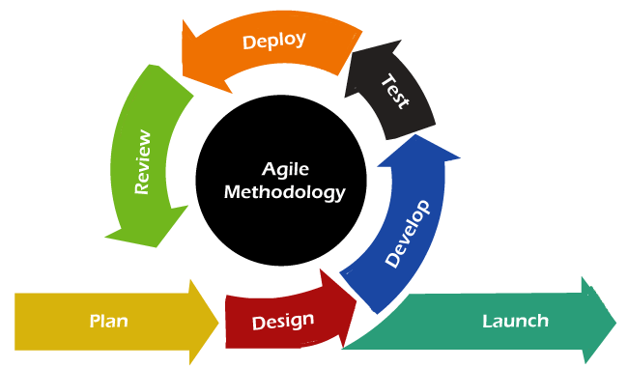
SDLC Model

Slide 7
Feasibility analysis
1. Technical Feasibility
Built with Python, Django, and ML (Random Forest).
Uses open-source tools like Scikit-learn and Pandas.
Easy to deploy on platforms like Heroku.
Feasible with available technologies.

Slide 8
Feasibility analysis
2. Operational Feasibility
Simple UI for symptom input and predictions.
Helps users and doctors with early insights.
Useful in rural/remote areas.
Feasible and user-friendly.

Slide 9
Feasibility analysis
3. Economic Feasibility
Uses free, open-source tools.
Low-cost development and maintenance.
Cost-effective solution.

Slide 10
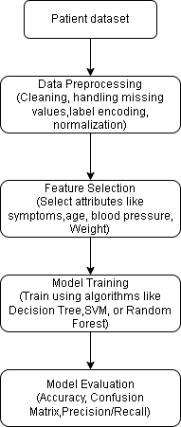
Methodology Diagram

Slide 11
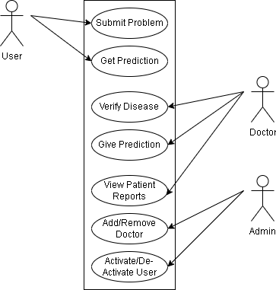
Use case Diagram

Slide 12
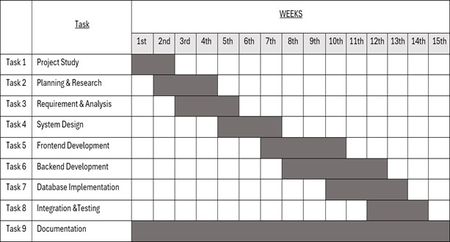
Gantt Chart

Slide 13
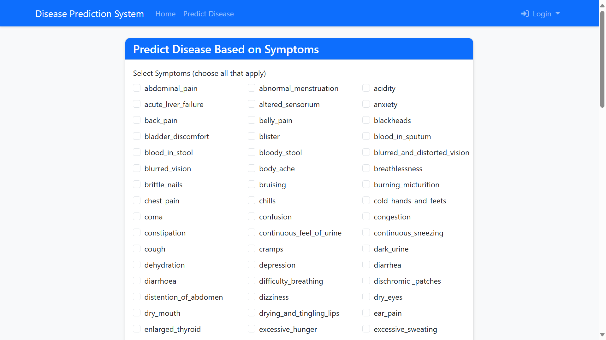
Output

Slide 14
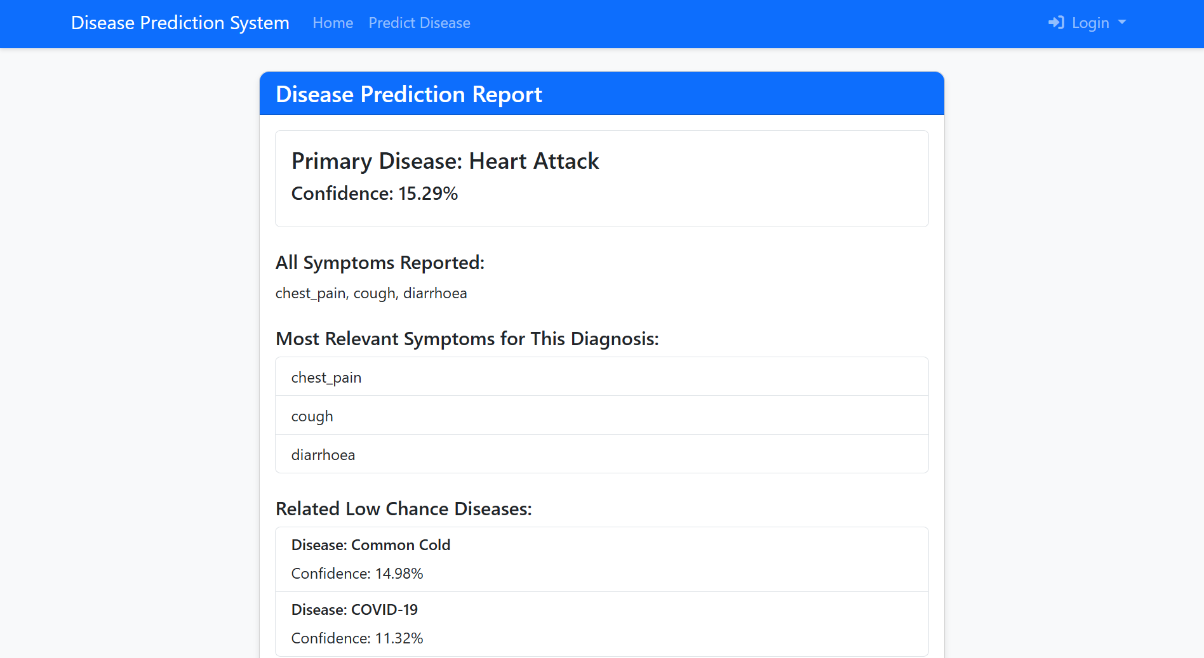
Output

Slide 15
Conclusion
Early detection saves lives.
Our Disease Prediction System makes healthcare fast, affordable, and accessible to everyone. By using machine learning and emerging technologies, we deliver smart, timely support right to your fingertips—no matter where you are.
Because everyone deserves better health.

Slide 16
Reference
[1] Scikit-learn Developers, “Random Forest Classifier — Scikit-learn Documentation,” [Online]. Available: https://scikit-learn.org/stable/modules/generated. [Accessed: June 10, 2025]. [2] Django Software Foundation, “Django Documentation – Web Framework for Perfectionists with Deadlines,” [Online]. Available: https://docs.djangoproject.com/en/4.2/. [Accessed: June 10, 2025]. [3] N. L. D. Anuradha, “The Agile Model in SDLC: A Flexible Approach to Software Development,” Medium, 2021. [Online]. Available: https://medium.com/@nld.anuradha/the-agile-model-in-sdlc-a-flexible-approach-tosoftware-development-664bf60ad9dc. [Accessed: June 20, 2025]. [4] UCI Machine Learning Repository, “Datasets for Symptom-Based Predictions,” [Online]. Available: https://archive.ics.uci.edu/ml/datasets/. [Accessed: June 8, 2025]. [5] GitHub Contributors, “Public Health Dataset Resources,” GitHub, [Online]. Available: https://github.com/datasets. [Accessed: June 8, 2025].

Slide 17
DO YOU HAVE ANY QUESTION FOR US ?

Slide 18
THANK YOU SO MUCH

